Slide 1

FORTUNA
Mighty Construction
Key Features Product:
Competitive Product Cost
Simplify Product Process
Maximum Product Out Put
Muhammad Zudi Sakuri
MHL JKT (FW D&S)
2012-08-03

Slide 2
Fortuna Mighty Construction
Fortuna Mighty Construction is one idea to simplify upper construction with using 1 or 2 layers upper construction to make simple process in mass production
Fortuna was chose as pilot item on this Kaizen Project Event because of low price Model that price always increase every season.
From this Kaizen event also in future also will demonstrate of Compatibility Product concept based on construction of shoe, number of worker according to shoes construction and also product price level to control and getting better product price in future.

Slide 3
Fortuna Mighty Construction
Kaizen Point:
Upper Construction
Fortuna Mighty Construction just used 2 upper construction as Vamp Lining and Main Upper.
2. Assembly Process
Used New Eva Counter Construction
Non Tacking
Reduce Rivet become 6pcs/prs from 14pcs/prs
2 Time Cementing (One Time Primer for upper only)
1 Time Cementing (One Time Primer for upper only): need long time period.

Slide 4
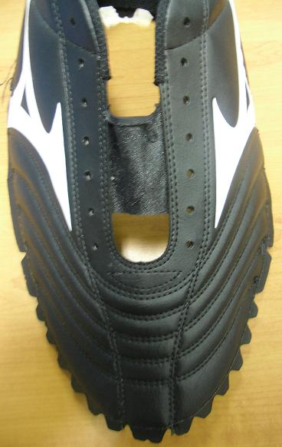
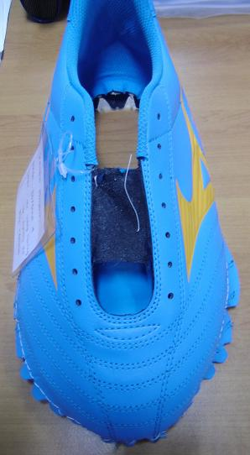
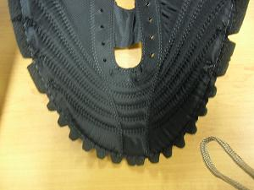
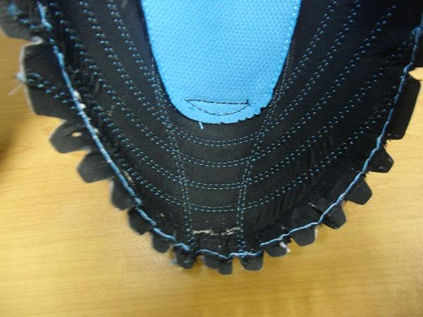
Fortuna Mighty Construction
1. Upper Construction
BEFORE
AFTER
Use Backing and Reinforcement
No Backing and Reinforcement

Slide 5
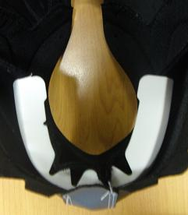
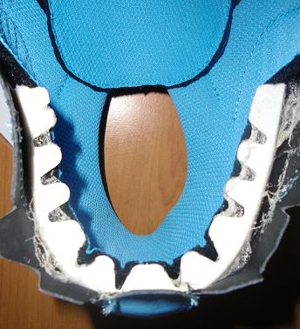
Fortuna Mighty Construction
2. ASSEMBLY PROCESS (New Eva Counter)
BEFORE
AFTER
Current Eva Counter Shape
New Eva Counter Shape

Slide 6
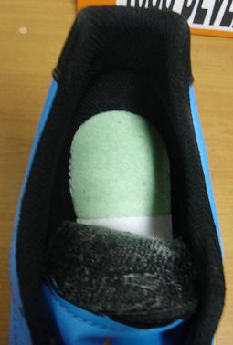
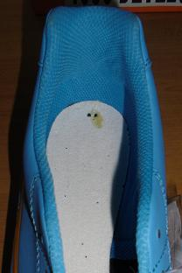
Fortuna Mighty Construction
2. ASSEMBLY PROCESS (Non Tacking)
BEFORE
AFTER
With Tacking
No Tacking

Slide 7
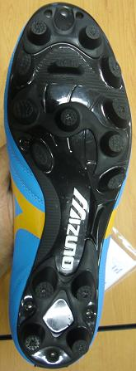
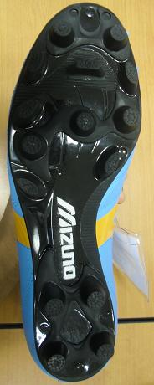
Fortuna Mighty Construction
2. ASSEMBLY PROCESS (Reduce Rivet)
BEFORE
AFTER
Toe: 3pcs
Toe: 1pcs
Mid: 1pcs
Mid: 1pcs
Heel: 3pcs
Heel: 1pcs
14 pcs / pairs
6 pcs / pairs

Slide 8
Fortuna Mighty Construction
3. Number of Man Power
BEFORE
AFTER
Target production per item: 140 prs / Hour
Standard man power: 157 person
Standard PPH: 0.89
Target production per item: 140 prs / Hour
Standard man power: 141 person
Standard PPH: 0.99

Slide 9
Fortuna Mighty Construction
3. Reduce price: US$ 0.54
BEFORE
AFTER
FOB Price: US$11.27
FOB Price: US$ 10.73
Reducer For:
Foam:0.12
R/F: 0.29
Backing:0.02
Rivet:0.08
Tacking:0.03

Slide 10
Fortuna Mighty Construction
Thank You For Further Goal

